Slide 1
england.primarycareops@nhs.net
Established to support unanswerable questions
Over 25 hours a week spent on managing queries from limited resource
Each query generates on average 3 further emails

Slide 2
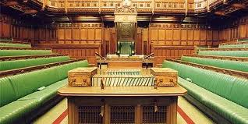
Generated queries
Freedom of information
Parliamentary questions
Department of health
Wider stakeholders
Area teams

Slide 3
Potential solutions
Close the generic primary care inbox
Or
Establish a rapid response virtual team who are field experts across each of the four areas of primary care
Communicate to colleagues within your area team to ask questions locally before raising nationally

